Slide 1
International Symposium on the UNCRPD implementation
Bochum, June 2013
Luk Zelderloo
Secretary General
EASPD
www.easpd.eu

Slide 2
EASPD in Brief
European Association of Service Providers for Persons with Disabilities
Based in Brussels, Not for Profit Organisation
Established in 1996
Objective: Equal opportunities for people with disabilities through effective and high quality service systems in Europe, which are affordable, available and adaptable.
EASPD represents over10000 service providers in 32 European countries covering all disabilities.

Slide 3
Outline
Challenges
Towards Community Living
Conclusions

Slide 4
I. Challenges
A Changing Society
Shift in paradigm with regard to persons with disabilities
Demographic change
Economic change
Knowledge society and ICT

Slide 5
UN Convention
Follow-up of the Standard Rules
Disability: no longer a medical but a social and citizens definition
Disability is an evolving concept
Persons with disabilities (PWD)
Faced with huge barriers
Risk of poverty
Multilayered discrimination
Holistic approach is needed
PWD should enjoy and contribute like everybody else
PWD are right holders

Slide 6
I. Challenges
Staff Training
First line workers in the social sector are mainly (up to 95 %) female.
Key issues:
Few career opportunities
Low wages
Few LLL opportunities (investment in human capital)
Needs for retraining due to paradigm shift (adaptability of workers)

Slide 7
I. Challenges
De-Institutionalization
There is an urgent need for the development of community based and person centred services across Europe in 3 areas of life: Education, Employment and Day to day support.
Key issues:
Retraining of staff in specialised settings
Training of staff working in the mainstream
Development of new job profiles
Training of social services management

Slide 8
I. Challenges
Differences in the ‘cultures’
Institutional care
Community care (CBS)
Isolation from broader community
Clients have not sufficient control over their live
Paternalistic relationship
Routine
Block treatment
Rules of the institution are more important the needs of the clients
Inclusion to the community
Involvements of the clients to all decisions
Partnership
Flexibility
Individual approach
Client in the centre

Slide 9
Mistakes during the transition process
I. Challenges
Over-investment in current institutions
Maintaining parallel services
Alternatives with institutional culture
Closure of institutions without community alternatives

Slide 10
I. Challenges
Availability of Services
Availability of a services spectrum and free choice are crucial for the well-being of PWD.
Innovation in social service provision could contribute to sustainable solutions.
Key issues:
Capacity building is needed in Eastern European countries
Needs assessment tools are to be developed
Funding?
New types of services, e.g. call centres, distance support..

Slide 11
I. Challenges
Stakeholder and Mainstream Cooperation
All stakeholders have to contribute to the development of efficient and cost effective service systems.
Today’s society is complex. Only through well-organised cooperation and shared responsibility, effective and efficient policy developments and implementation is possible.
Key issues:
Identification of stakeholders
Agreement on different roles and responsibilities
Development of tools and instruments facilitating cooperation
Funding of stakeholder cooperation

Slide 12
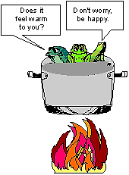
1. The Frog Phenomenon
II. Towards
Community-based Living
So, needed is:
Focus on needs and needs assessment
Developing and showing alternatives (availability)
Explaining the importance of the change in paradigm
Training change management
Training new skills for first line staff
Identify bottlenecks in legislation and underlying frameworks
Alternative employment opportunities for staff

Slide 13
2. Family Support
II. Towards
Community-based Living
So, needed is:
Socio-economic support mechanism for poor families
Communication support
Recognition of different roles: parents/brothers, sisters

Slide 14
3. Service Spectrum
II. Towards
Community-based Living
So, needed is:
Available information services
Aware and trained staff in maternity hospitals
Early intervention and ambulant services
Personal assistants in day care and schools
Respite care services and temporary care
Family support combined with support for persons with disabilities
Focus on transition in life stages
Available support in mainstream education and health care
The end of the total "institutions" means more flexible solutions

Slide 15
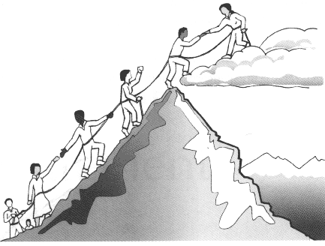
4. Develop Partnerships
II. Towards
Community-based Living
So, needed is:
Invest in stakeholder cooperation and involvement of people with disabilities
Recognition of different roles
Commitment of all partners
Mainstreaming

Slide 16
5. Cut the Supply Line
II. Towards
Community-based Living
So, needed is:
Flexible time frames for services (pre-school programs)
Identify the number of persons living in the institutes
Stop investment in the buildings
Agreed plans for breakdown
Legal ‘stop’

Slide 17
6. Install Snowball Mechanism
II. Towards
Community-based Living
So, needed is:
Structural involvement of persons with disabilities
Identify perverting effects of not specific legislation
Include quality of life in quality of services instruments

Slide 18
10 key quality requirements for social services
III. Conclusions
To facilitate full participation, inclusion and equal citizenship
To be built around people with disabilities and their changing needs: tailor made – person centered
To be community based and rooted in society
To be set up in, and in close cooperation with the mainstream
Holistic approach → multi faceted approach

Slide 19
10 key quality requirements for social services
III. Conclusions
6. Be provided by well trained and managed staff
7. Keep the family together
8. Be based on stakeholder cooperation
9. Ensure security to all users
10. Allow real and informed choices

Slide 20
If you fail to plan, you plan to fail
III. Conclusions
Key challenges for the years to come:
Bring the support to the people
Bring know-how to the mainstream
Further develop knowledge and expertise

